Slide 1
CAPSTONE PROJECT
RESTAURANT MANAGEMENT SYSTEM
Presented By:
HARI PRAKASH S- 2021311308
B.TECH PETROLEUM ENGINEERING AND TECHNOLOGY
ACTECH-ANNA UNIVERSITY

Slide 2
OUTLINE
Problem Statement
Proposed System/Solution
System Development Approach
Algorithm & Deployment
Result
Conclusion
Future Scope
References

Slide 3
PROBLEM STATEMENT
The current manual billing process leads to delays for both customers and the organization, creating an opportunity for enhancement. Introducing a computer-based billing system could streamline resource utilization. This system enables efficient data entry for client, employee, and payment information, streamlining record management and addressing organizational data needs. Key issues with the existing system include:
Limited flexibility for data modification
Reliance on manual operator oversight
Excessive paperwork generation
Difficulty in accessing information promptly
Challenges in systematically recording data
Paper wastage

Slide 4
PROPOSED SOLUTION
The Restaurant Management System (RMS) is a computerized tool that simplifies and speeds up customer billing in restaurants. It has a user-friendly interface that allows staff to manage customer bills efficiently, significantly reducing processing time. RMS can handle large data volumes and quickly generate customer bills. It also provides easy access to records such as billing history, reservation details, and staff information.
RMS is designed for simplicity and ease of use, automating tasks like customer billing and applying discounts. It minimizes the need for paperwork, as all data is entered directly into the computer and stored in a database. This ensures data security and reduces the risk of loss or damage. The system's automated features streamline restaurant operations, making them more efficient and reducing the need for manual record-keeping. Overall, RMS helps restaurants operate smoothly by digitizing critical processes like billing, reservations, and staff management.

Slide 5
SYSTEM APPROACH
Developing a restaurant management system in Python involves a methodical approach, which includes the following phases:
Requirements Understanding:
Begin by thoroughly grasping the system's requirements, encompassing menu management, order processing, reservations, inventory tracking, and reporting functionalities.
Module Organization:
Structure the system into distinct modules, each addressing specific functions such as Menu Management, Order Processing, Reservation Handling, Inventory Control, and Reporting.
Class Definition:
Define classes within each module to encapsulate entities and actions. These classes may include Menu Items, Orders, Reservations, and Inventory Items.
Establishing Relationships:
Establish connections between classes/modules to represent their interactions. This could involve defining how orders relate to menu items and how inventory levels are affected by orders.

Slide 6
Functionality Implementation:
Implement methods and functions within each class/module to carry out required operations, such as updating menus, processing orders, managing inventory, and handling reservations.
Optional User Interface:
Depending on requirements, design a user interface using options like a command-line interface, a graphical interface using libraries such as Tkinter or PyQt, or a web-based interface using frameworks like Flask or Django.
Testing and Refinement:
Conduct thorough testing to verify the system's correctness and adherence to requirements. Iterate on the system based on testing results and user feedback to refine its functionality.
Documentation:
Document the system's architecture, functionalities, and usage instructions to aid in future maintenance and enhancement efforts. This documentation serves as a valuable resource for developers and users alike.

Slide 7
ALGORITM & DEPLOYMENT
Algorithm for Restaurant Management System
Menu Management:
Define a Menu Item class with attributes such as name, price, and description.
Create a Menu class to manage menu items.
Implement methods for adding, removing, and displaying menu items.
Order Processing:
Define an Order class with attributes like order_id, items, and total_price.
Create methods for adding items to the order, calculating the total price, and processing the order.
Reservation Management:
Define a Reservation class with attributes like reservation_id, customer_name, date_time, and table_number.
Implement methods for making reservations, checking availability, and canceling reservations.
Inventory Management:
Define an Inventory class with attributes like item_name, quantity, and price.
Create methods for managing inventory items, such as adding stock, updating quantities, and generating low stock alerts.
Reporting:
Implement functionality to generate various reports, such as sales and inventory reports, based on user requirements.

Slide 8
User Interface:
Design a user interface for interacting with the system, such as a command-line interface, web-based interface, or GUI, depending on deployment choice.
Deployment Options:
Local Deployment:
Run the Python program on a local machine, with users interacting through the command line.
Package the application using tools like PyInstaller for easy distribution.
Web-Based Deployment:
Develop a web application using frameworks like Flask or Django.
Host the web application on a server, allowing users to access it from anywhere with an internet connection.
Mobile App Deployment:
Develop a mobile application using frameworks like Kivy or React Native.
Deploy the app to app stores for users to download and install on their devices.
Containerization:
Containerize the application using Docker for easy deployment and scalability.
Deploy the Docker containers to platforms like Kubernetes for orchestration.
Hybrid Deployment:
Combine multiple deployment options to cater to various requirements, such as having both a web-based system for online orders and reservations and a local system for in-house operations.

Slide 9
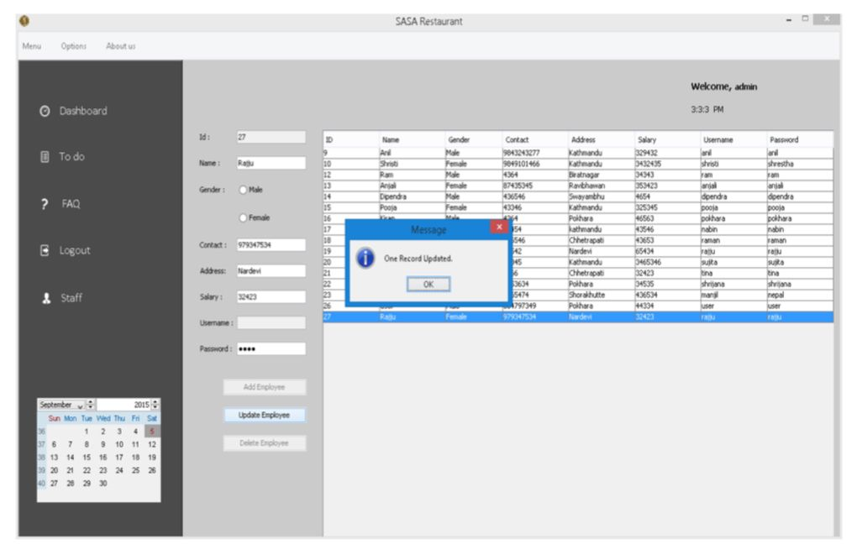
RESULT
Reviewing the outcomes of the Restaurant Billing System, it efficiently manages staff details, customer reservations, billing processes, and more. Upon analysis, the system demonstrates robust functionality for staff data management, encompassing tasks like addition, editing, updating, and deletion. Additionally, it supports reservation creation, cancellation, and bill printing for customers. The system's outputs are visually represented in the figures below.
Updating customer information

Slide 10
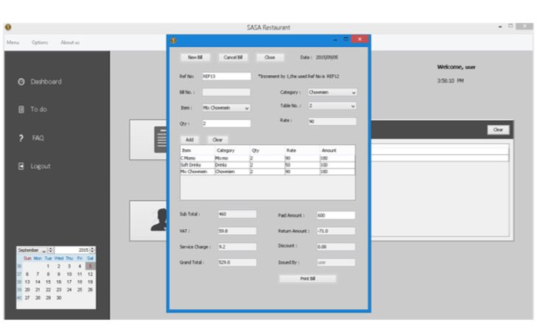
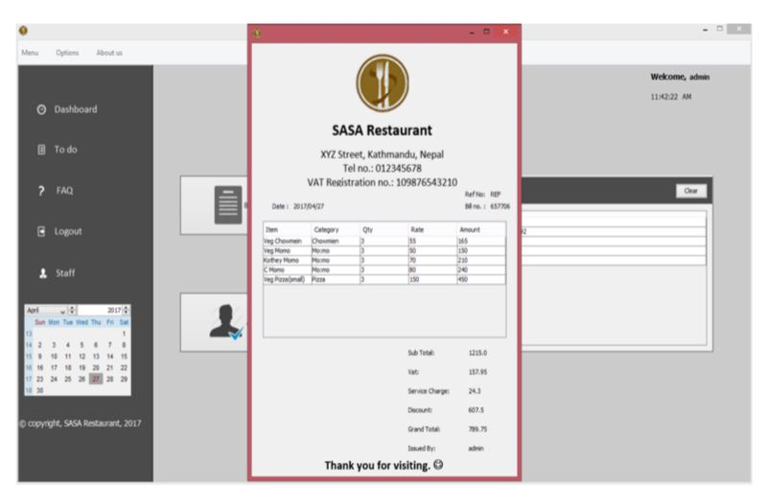
Billing Output
Billing Print Output

Slide 11
CONCLUSION
The documentation outlines the structure and coding of the Restaurant Management system. Building this program was a complex task requiring detailed analysis, thorough research, and specific technical skills. Creating this report has been an enlightening experience, offering numerous insights as the challenges were substantial. Developing a system for a restaurant demanded a combination of research and coding expertise, and achieving a smooth operational flow took significant effort and time.
Despite the hurdles, the system was completed with a strong design and efficient operations. The billing system posed the greatest challenge. Extracting data from the database for billing purposes required intricate SQL queries and involved managing multiple database changes, which was time-consuming and required careful planning.
Overall, this project provided valuable coding experience and highlighted the importance of time management and teamwork in developing software systems.

Slide 12
FUTURE SCOPE
Restaurant management software (RMS) provides a comprehensive suite of features essential for running a restaurant smoothly, including staff management, order processing, billing, menu administration, reservation handling, order history tracking, task management, and more. Looking ahead, the software is primed for future enhancements and upgrades to expand its capabilities. Potential improvements such as advanced inventory management, wireless tableside ordering and payment systems, real-time alerts, online ordering integration, and mobile management functionalities have the potential to drive revenue growth and operational efficiency gains.

Slide 13
REFERENCES
Restaurant Billing System: https://www.scribd.com/doc/283903672/Online-Ordering-System-
Project Objective : https://www.scribd.com/document/36253350/04-Project-Billing- System
Scopes and Limitation: https://kungfumas.files.wordpress.com/2017/09/099.pdf
Feasibility study: http://www.slideshare.net/alok104/synopsis-on-billing-system-27487568
UML Diagram : https://www.techopedia.com/definition/3243/unified-modeling-language-uml/
Use Case Diagram: http://whatis.techtarget.com/definition/use-case-diagram
Class Diagram: http://searchmicroservices.techtarget.com/definition/class-diagram
Sequence Diagram : https://creately.com/blog/diagrams/sequence-diagram-tutorial/
ER Diagram: http://searchcrm.techtarget.com/definition/entity-relationship-diagram
Interfaces : https://www.youtube.com/watch?v=9K5sS7j5wWI

Slide 14
THANK YOU

